Slide 1



Victim First
Annual Report
Year 1
2024 - 2025

Slide 2




Performance Snapshot
We received
34,291
referrals this year.
15,906 of these were valid.
Our triage team made ‘positive’ contact with 10,459
victims.
97.8%
of service users were satisfied with the support they received from Victim First

Slide 3

Closer Look into Referrals

Slide 4
Stakeholder Feedback
Conducted in January 2025.
100%
of respondents agreed that making a referral to Victim First is user-friendly.
100%
of respondents agreed that they would refer a service user to Victim First again.
90%
of respondents fed back that Victim First shows willingness to engage and work with partner agencies.
90%
of respondents understand what to expect from Victim First and what support they can offer a service user
“I think it's a great service that is based on client needs - keep up the great work!.”
“Clients that I have referred in the past, have said they felt listened to and supported”
“We work very well with Victim First and they have a really good team. ”
“Friendly, knowledgeable, approachable team.”
“They are a professional team who are welcoming to other professionals and want to work closely with partner agencies”
“ VF are always willing to work on improving their service and offer and value communities”

Slide 5
Service User Feedback
“My experience was amazing. The support from Chloe and how I became so strong was because of her. She’s absolutely amazing and incredible at her job.”
“I felt safe, listened too, validated, the staff were professional, mindful and compassionate, an exceptional service.”
“Gentleman was really empathetic, funny and tried everything to resolve our case, really good and understanding…”
“Had regular contact with caseworker and timescales given for this, for when to expect a call. Keeping support open until I was ready to have it closed, was not pushed for this to be closed. Personal alarm provided. Was provided with what was offered and with reassurance.”
97.8%
of the service users who were surveyed said that they were satisfied with the support they received from Victim First.
We had 123 survey responses in the year. This is a project we are taking into the new year.

Slide 6
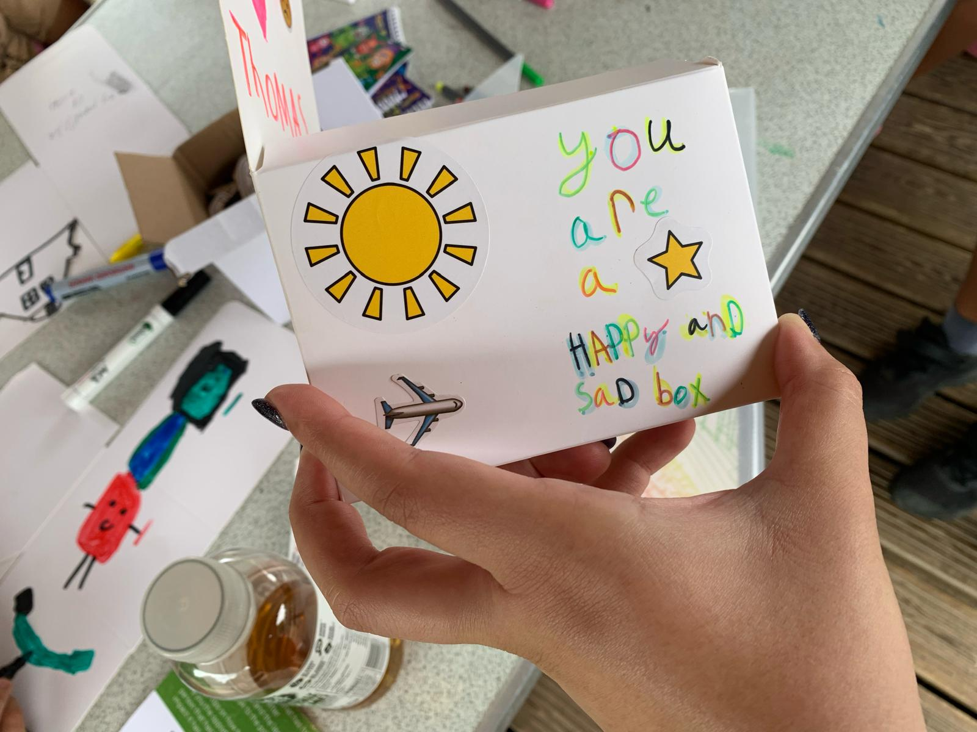
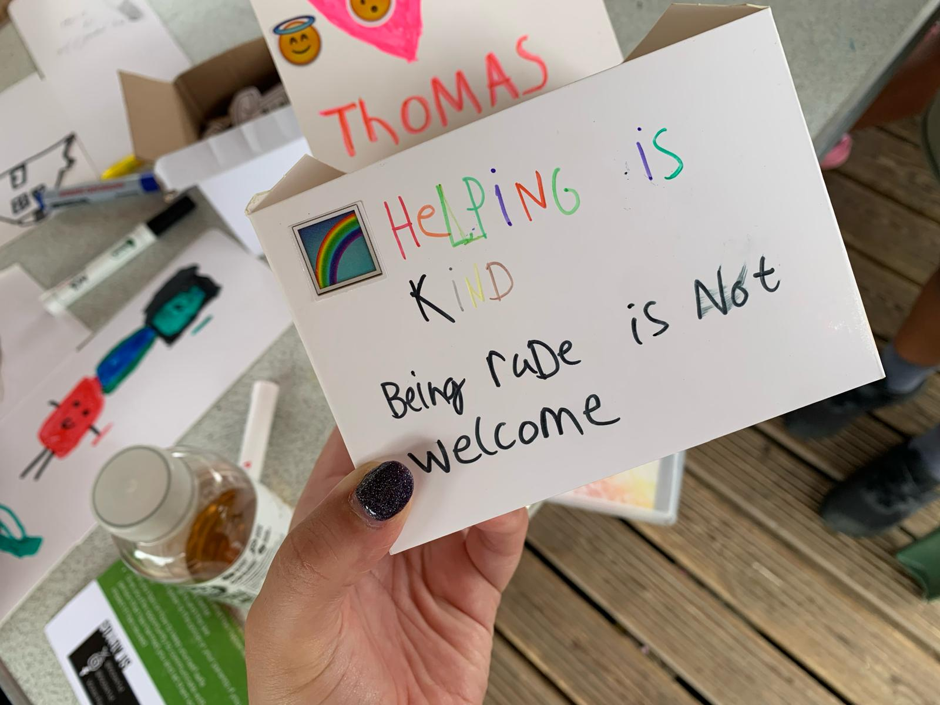
'I have enjoyed having this, I enjoy speaking to you and I find it very calming’​
​
Feedback from 8-year-old Service User
Victim First Futures
We received
677
referrals where the victim is under 18 years old.
We received
759
referrals where the victim is aged between 18-24.
'Victim First Futures were great at supporting with an escalation with the young person. They made the child smile and feel listened too.’
Feedback from School Safeguarding Lead
What has Victim First Futures helped you with the most?
‘Speaking about my feelings and worries’​
​
Feedback from 10-year-old Service User

Slide 7

Restorative Justice
We received 38 internal referrals.
We received 21 external referrals.
We had 67 RJ outcomes, including:
1 x Face to Face Conference
40 RJ Conversations
11 Shuttle RJ (exchange of letters)
1 x Out of Court Resolutions Team – initiated and terms complied with
14 x victim provided with initial information on RJ

Slide 8

Community Responses
We have worked on 4 community responses this year:
Ops Signpost in New Parks
Franklin Park Incident
Manor High – Knife Crime Incident
Melton Mowbray – ASB / Burglaries
“Thank you for your participation in the recent response sessions for Braunstone Town residents. It was inspiring to see everyone come together to share insights and support one another”
Hannah Williams – Neighbourhood Lead Mental Health (Blaby)

Slide 9
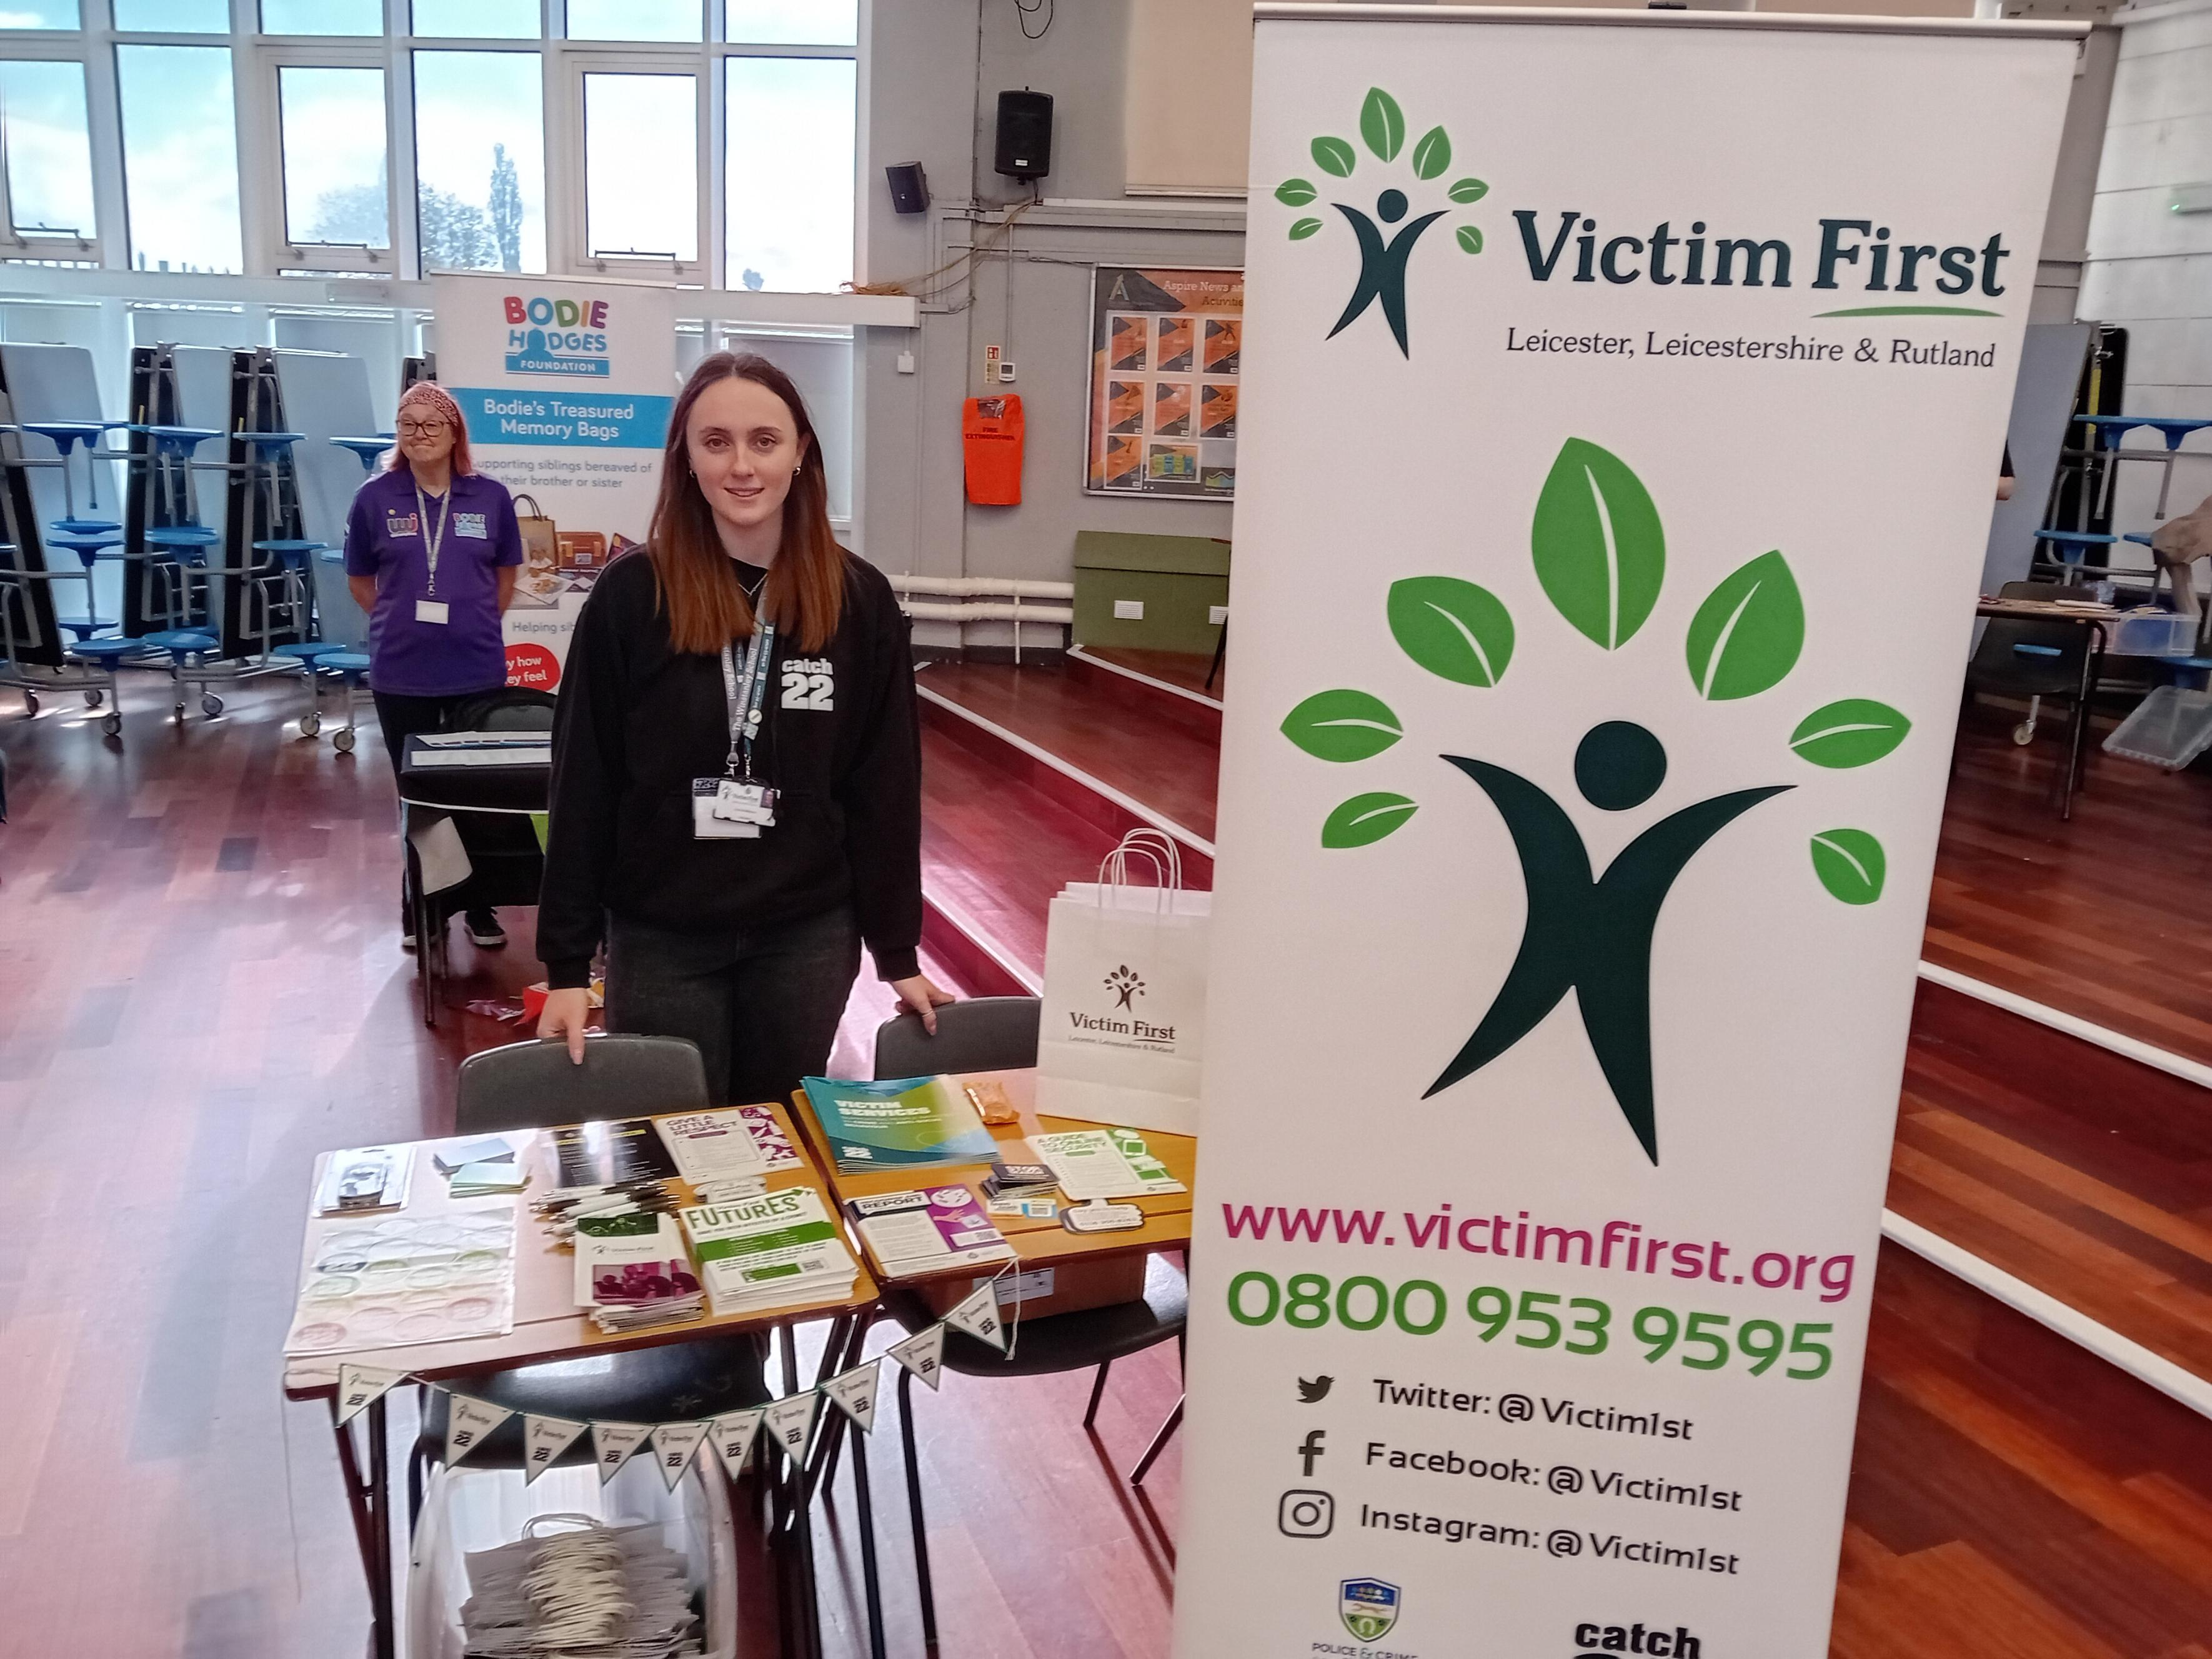
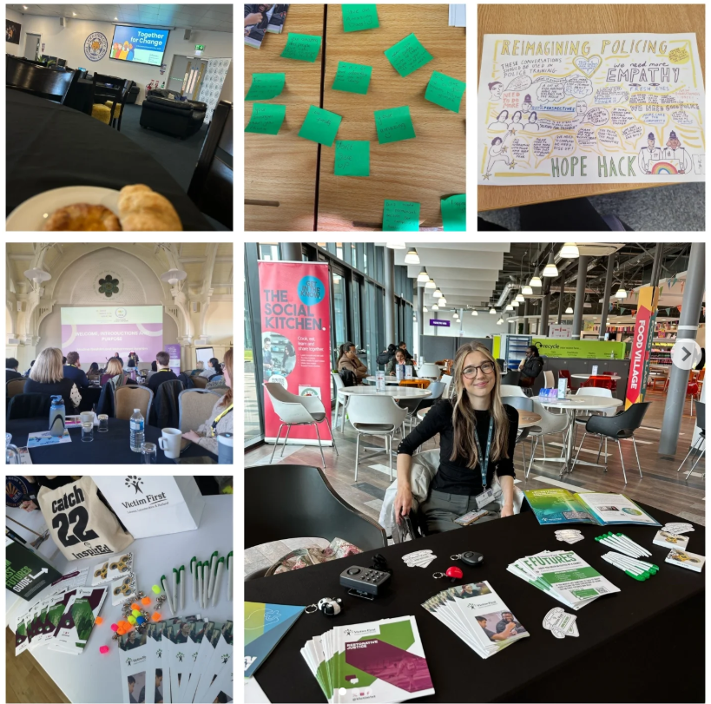
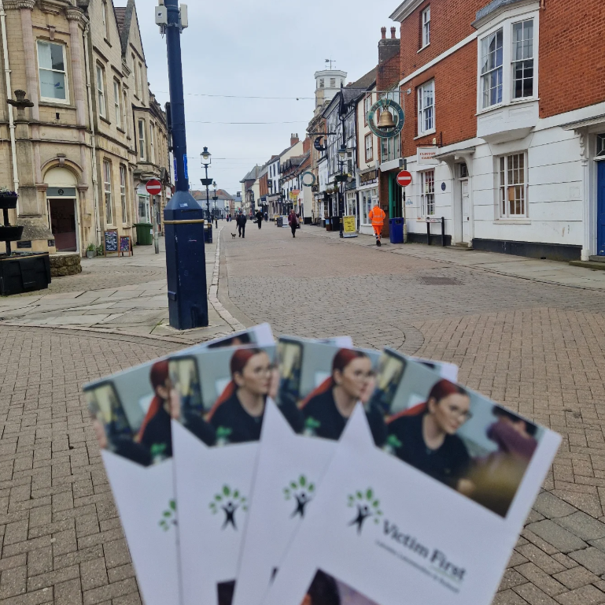
Community Engagement
We attended 70 events this year.
We spent 227.5 hours in the community, supporting the community.
We delivered inputs to 445 different professionals.

Slide 10
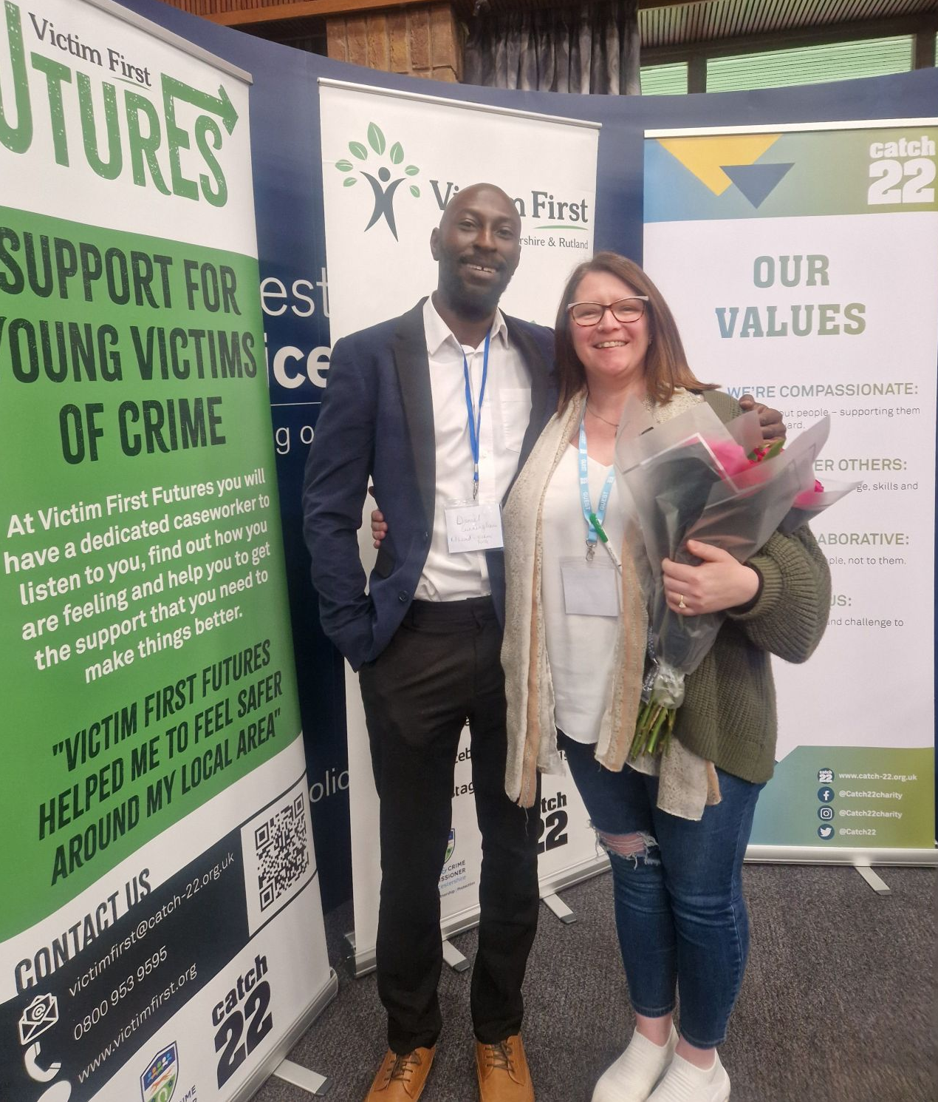
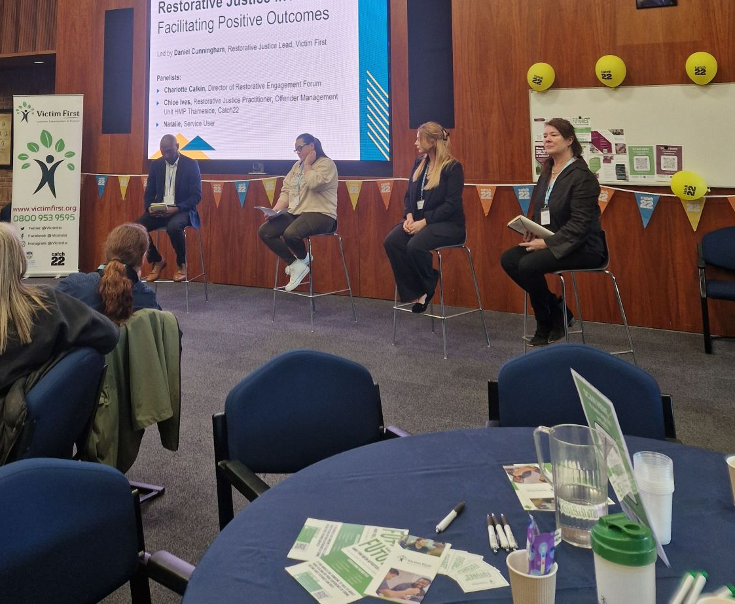
Key Achievements
Please use Akkurat if presenting or Arial if sharing with people outside of the organisation. Typefaces are available for download on the Comms Support Hub.
Add media such as videos, graphs and tables by clicking the corresponding central icons. Please avoid using clip art or any images not from the Catch22 illustration and photo bank.
Our first annual conference
We won some funding to deliver workshops to young people
We won £5k from Catch22 to deliver restorative practices work at a local school
Working towards achieving ISO9001 Accreditation

