Slide 1



Victim First
Annual Report
Year 2
2025 - 2026

Slide 2




Performance Snapshot
We received
30,553
referrals this year.
11,906 of these were valid.
Our triage team made ‘positive’ contact with 8,901
victims.
91.8%
of service users were satisfied with the support they received from Victim First

Slide 3


Victim Pathway Team
In October we implemented a partnership with the Victim Pathway Team. The VPT review all domestic abuse cases referred by the police. Following this they will ensure suitable support has been offered and appropriate support in place, including standard risk to Victim First.
They're available for additional checks where referral information may need further review; and reengage with victims who may have initially declined to ensure awareness of Victim Services.
Statistics:
Number of Occurrence’s reviewed- (not including additional checks from VF)- 5,586 Occurrences
Suitable and sent to Victim First- 540
Compliant occurrences- Referred to other support agencies by OIC- 2,029
Victim declined support from any support agencies. Includes all risks- 2,666
Re-engage calls made to suitable Stand risk victims- 160
Referrals made following contact- 29

Slide 4

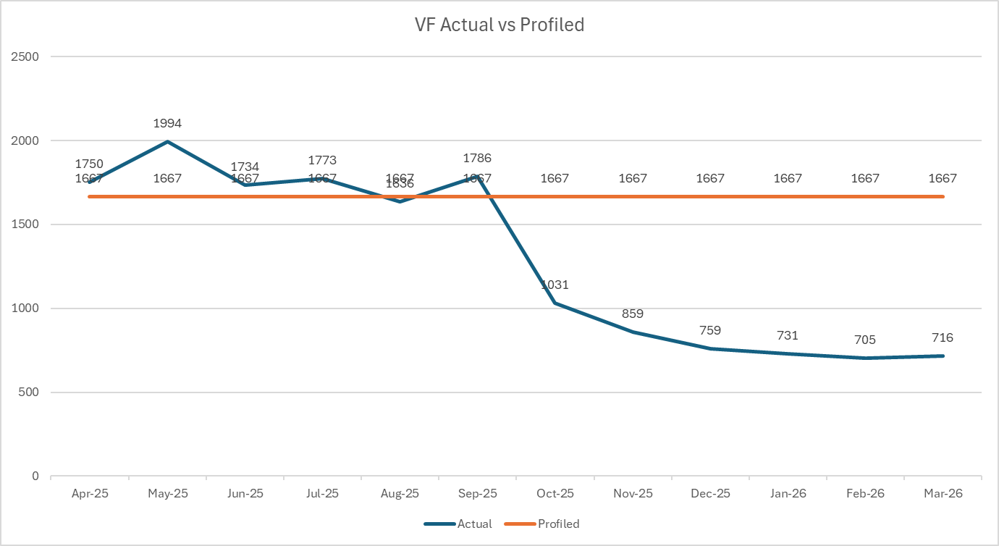
Closer Look into Referrals

Slide 5
Service Quality & Referral Pathways
100%
of respondents agreed that making a referral to Victim First is user-friendly.
100%
of respondents agreed that they would refer a service user to Victim First again.
100%
of respondents understand what to expect from Victim First services.
100%
of respondents agreed or strongly agreed that:
Victim First provides a quality service
Caseworkers are skilled and experienced
Victim First is effective in supporting victims and witnesses
“VF offers great practical support and emotional support for victims.”
“Knowing we’ve referred, clients are in good hands.”
“Excellent service assisting victims impartially – continue with the good work.”
“A very proactive service, with wonderful staff who explain the service in more detail.”
"We value the team very highly"

Slide 6
Partnership & Communication Responses:
100%
of respondents agreed Victim First is accessible and contactable
100%
of respondents feel communication is appropriate and effective
100%
of respondents feel Victim First shows a willingness to engage and work with partners
80%
of respondents agreed that Victim First has a strong presence within the community (20% neutral)
“ I have always found the people working at Victim First engaging, friendly and enthusiastic, a pleasure to work with.''
"Great team - very productive and accomplished"
"Victim First engages well with partner agencies"
"Your social media is always good!"
"The team are all extremely knowledgeable, friendly and provide fantastic support. The team are professional and great at communicating."

Slide 7
Service User Feedback
"She made me feel heard, understood and more importantly the priceless opportunity for me and my girl to finally feel safe and protected in our own home again. I owe her everything for giving me back my peace of mind and some independence at such a difficult time"
Adult Service User
"Cared about how I was feeling. Answered many of my ‘why?’ questions. Helped me understand that the trial verdict wasn’t my fault. Helped me regain my confidence to face the world again"
Adult Service User
"Extremely helpful and supportive both now and for the future"
Adult service user
"Understanding what happened wasn’t my fault"
CYP Service User
190
of our service users said
that they were satisfied with the support they received from
Victim First
Notes:
This feedback has come from service users who completed our online or over the phone survey

Slide 8
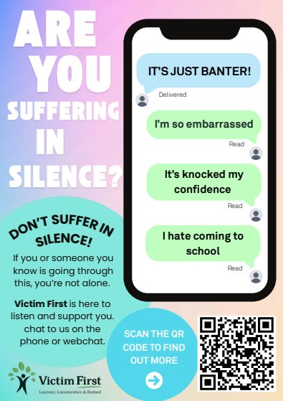
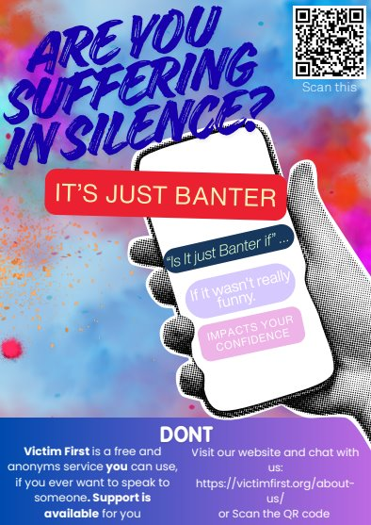
Victim First Futures
Our young people poster:
Following feedback from our stake holder feedback session, it was bought to our attention that our young people did not like the Victim First Futures posters and it didn’t speak to them
Since then, we have been meeting with a group of young people to co-design a poster
Victim First are creating one, and the young people involved are also creating one.
We received
839
referrals where the victim is under 18 years old.
We received
874
referrals where the victim is aged between 18-24.
What has Victim First Futures helped you with the most?
"Making me able to go outside again"​
Feedback from 12-year-old Service User
What has Victim First Futures helped you with the most?
" Understanding what happened wasn’t my fault"​
Feedback from 16-year-old Service User

Slide 9

Restorative Justice
We received 17 internal referrals.
We received 20 external referrals.
We had 43 RJ outcomes, including:
1 x Face to Face Conference
14 Shuttle RJ (exchange of letters)
8 Shuttle RJ (verbal exchange)
20x victim provided with initial information on RJ

Slide 10

Community Responses
We have worked on 3 community responses this year:
Littlethorpe
Stathern Summer Camp
De Montfort University
“Again, really grateful for the support and the collaboration – building community in this way is so vital. We continue to flag your services to our students wherever relevant.”
“I wanted to thank you and the team at Victim First for your support and presence in the aftermath of Khaleeds murder, you were so appreciated.”
De Monfort Unive​sity

Slide 11
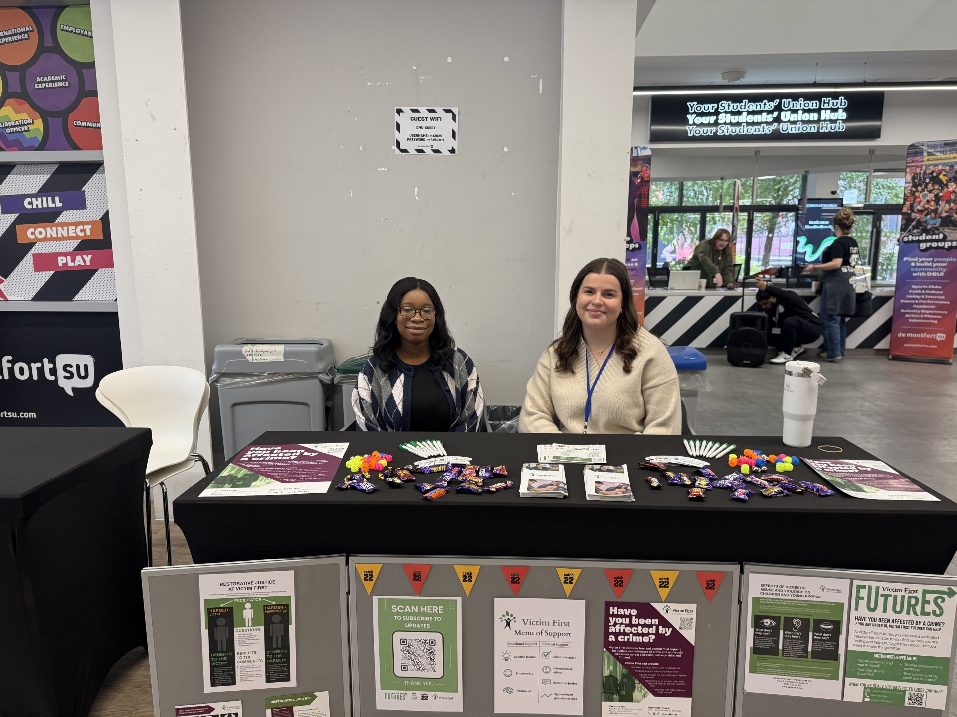
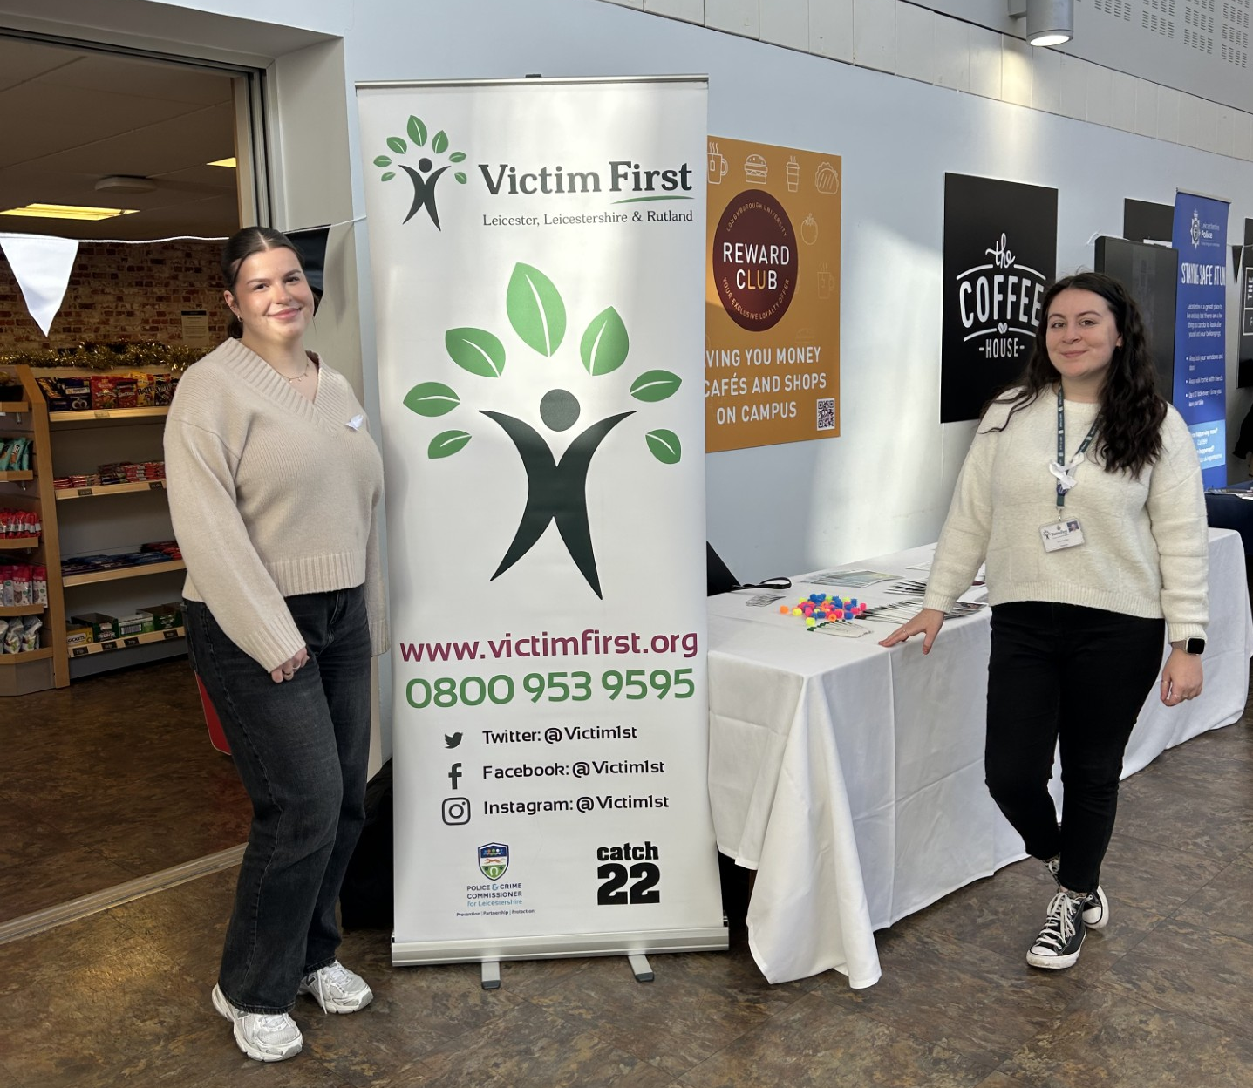
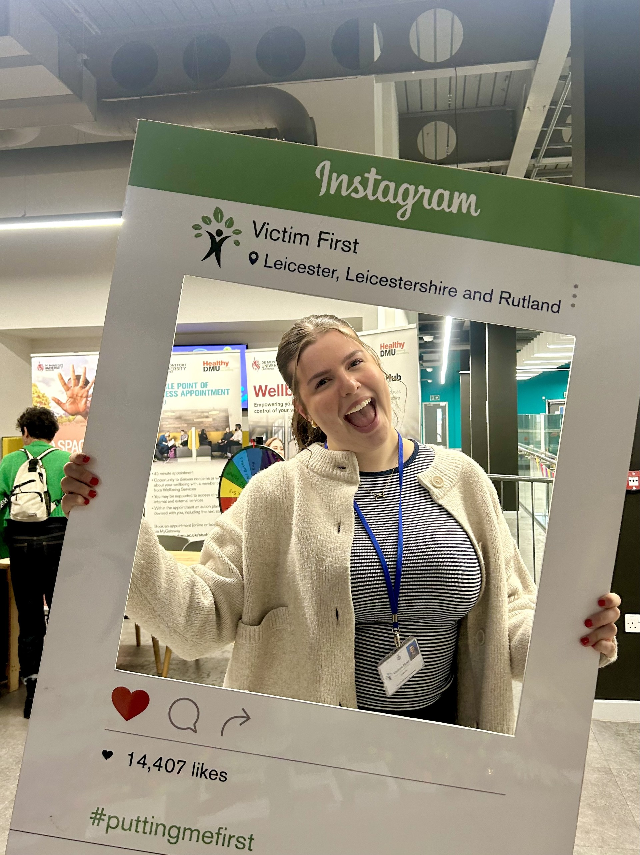
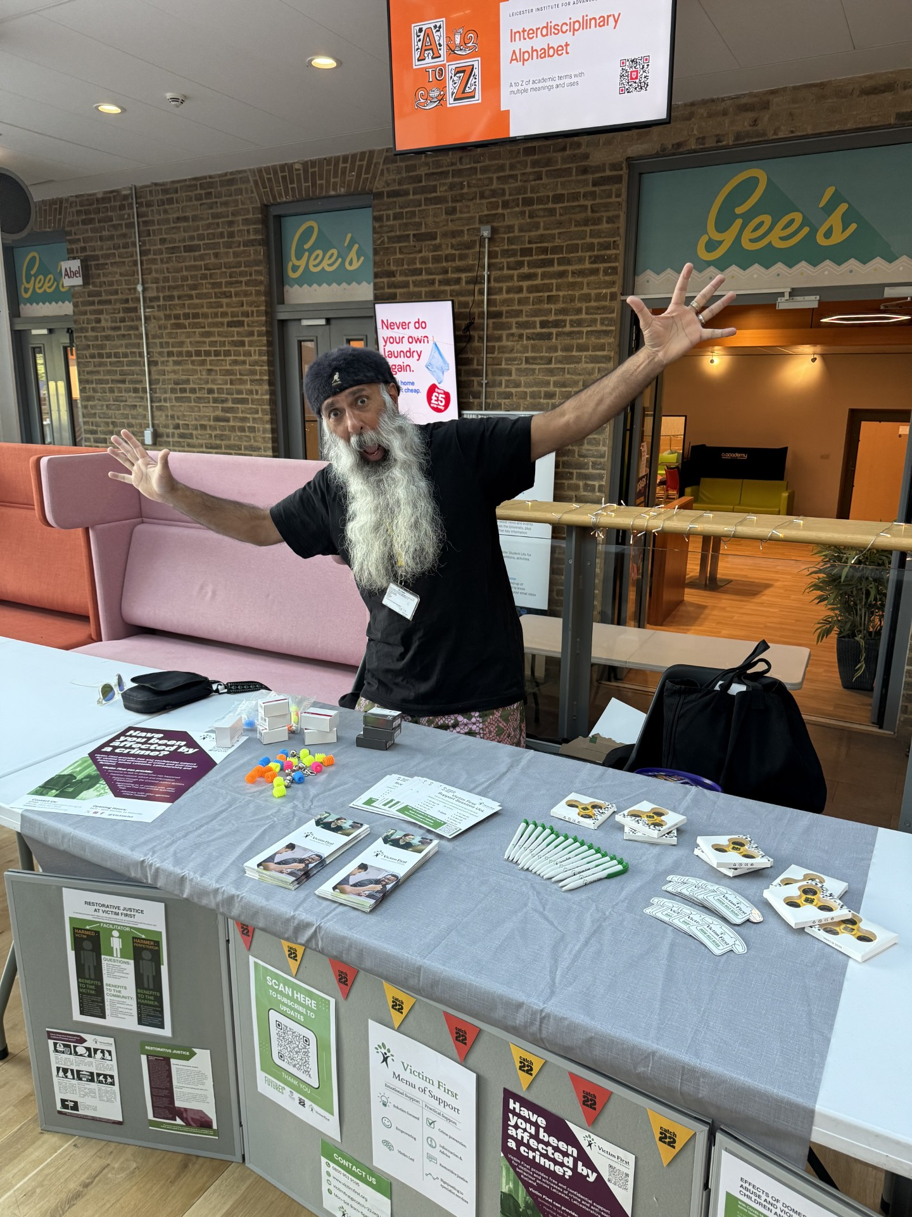
Community Engagement
We attended 64 events this year.
We spent 142.5 hours in the community, supporting the community.
This reached 343 professionals and 819 members of the community

Slide 12
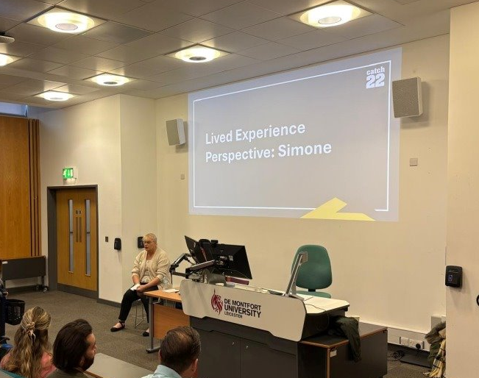
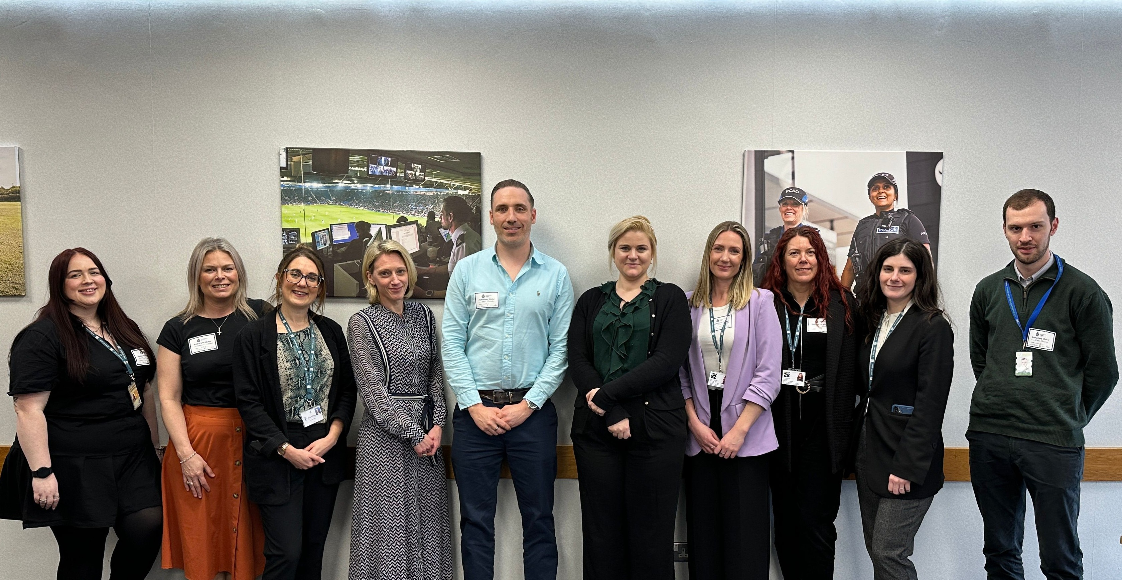
Key Achievements
Please use Akkurat if presenting or Arial if sharing with people outside of the organisation. Typefaces are available for download on the Comms Support Hub.
Add media such as videos, graphs and tables by clicking the corresponding central icons. Please avoid using clip art or any images not from the Catch22 illustration and photo bank.
June - We achieved ISO9001 Quality Assurance- Accreditation
October - Implementation of the Victim Pathway Team in collaboration with the LLR Police
October - Our service user Simone creating case study videos and attending our Victim's Conference
March - Victim Minister and Victim Commissioner Visit

